Slide 1
Face Detection Using Opencv
BY:-
S.YAMINI
K.P.YADURAJ

Slide 2
CONTENTS
INTRODUCTION
ADVANATGES AND DISADVANTAGES
APPLICATIONS

Slide 3
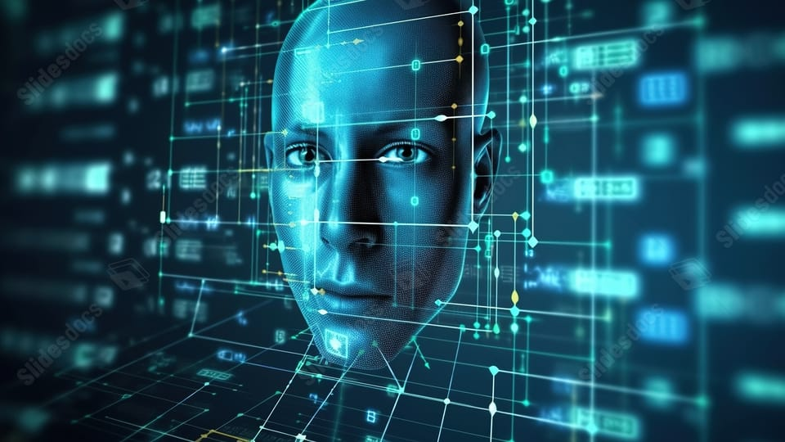
INTRODUCTION
In recent years, computer vision has witnessed remarkable advancements, particularly in tasks like face detection, thanks to libraries like OpenCV (Open Source Computer Vision Library). Face detection, a fundamental task in computer vision, has a wide range of applications, from security surveillance to image editing and social media filters.
WHAT IS FACE DETECTION ?
Face detection is the process of locating human faces in images or video frames. It involves analyzing the visual content of an image to determine whether and where faces are present. This task serves as a crucial building block for more complex face recognition and analysis systems.

Slide 4
ADVANTAGES :
Personalization
Security Enhancement
Improved User Experience
Convienence And Efficiency
Accessablity
Real-Time Monitoring.

Slide 5
DISADVANTAGES
Privacy Concerns
Environmental Limitations
Face detection raises significant privacy concerns as it involves capturing and analysing individuals.
Face Detection performance can be affected by the environment like lightning, Camera Angles etc.
03
04
Social Implications
The widespread adoption of face detection technology may alter dynamics of trust and surveillance in public spaces, basically leading to discomfort or distress.
Overreliance on Technology
02
05
This means leading to the complacenct and the neglet of other security measuresor human judgement.
Potential for Misuse
01
06
Security Vulnerabilities
This technology has the potential to misuse or abuse by authoirtarian regimes,survillance state practices.
Face Detection systems are suspectable to security vulnerabilities and exploitations.

Slide 6
APPLICATIONS OF OPENCV
Biometric Authentication
Security and survillance
Face detection is the key component of the biometric authentications. Used in smartphones , banks etc..
Face detection is extensively used in Security systems for Surveillance Purpose.
Access Control
Smart Retail
Face detection technology Is employed in access control systems.
Use Face detection to analyze customer demographics and behavior.
Automated Attendence Systems
Entertainment And Marketing
Face dectection can automate the attendence tracking process. By recogonizing and logging individuals.
Face detection powers interactive experiences In gaming, Virtual Reality(VR), & Augmented Reality(AR

Slide 7

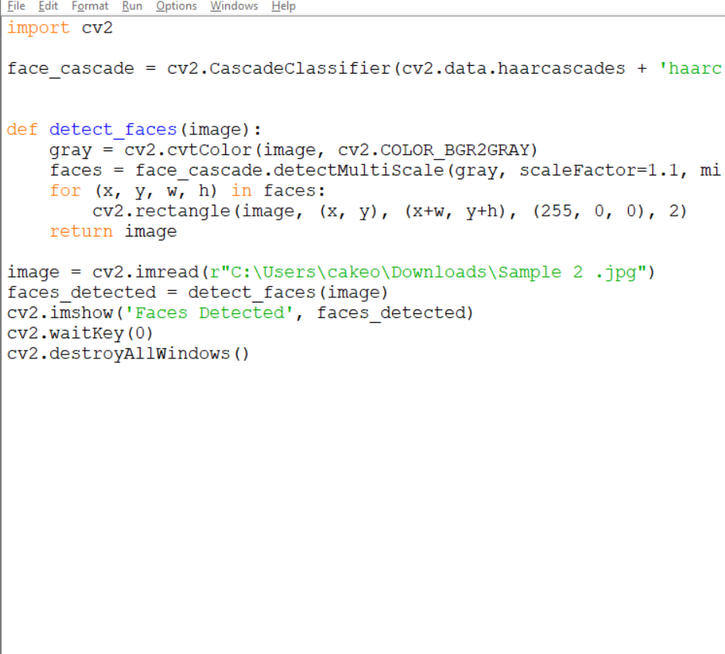

Slide 8
The face detection report highlights the significant advancements and applications of face detection technology in various domains, including security, entertainment, healthcare, and marketing. Throughout the report, we explored the underlying algorithms, techniques, and challenges associated with face detection systems.
From its humble beginnings to the current state-of-the-art solutions, face detection has evolved rapidly, driven by advancements in computer vision, machine learning, and deep learning. These technologies have enabled accurate and real-time detection of human faces in diverse environments and conditions, revolutionizing how we interact with digital devices and services.
While face detection offers numerous benefits, including enhanced security, personalized user experiences, and improved accessibility, it also raises important ethical and privacy considerations. Issues such as consent, data protection, and potential biases in algorithms require careful attention to ensure responsible and ethical deployment of face detection systems.
CONCLUSION

Slide 9


